Slide 1
Project Overview

Slide 2
Project Facts
1
2
Main Goal & Objectives
Approach
3
4
Advanced Supporting Technologies
Pilots
5
6
Expected Impact
Timeline
7
8
Consortium

Slide 3
1
Project Facts

Slide 4
Project Facts
1
Full title: A Holistic Approach to Sustainable, Digital EU Agriculture, Forestry, Livestock and Rural Development based on Reconfigurable Aerial Enablers and Edge Artificial Intelligence-on-Demand Systems
Duration: 36 months, starting from 1 July 2022
Budget: € 5,949,747
Consortium: 12 partners from 9 European countries
Demonstrations: in 3 European pilot sites
Work Programme: Horizon Europe
GA No: 101060529
Coordinator: ACCELIGENCE LTD

Slide 5
2
Main Goal & Objectives

Slide 6
Main Goal
2
CHAMELEON aims to optimise production and identify potential problems in agriculture, livestock, forestry and rural areas
To achieve this, the CHAMELEON Project will use a novel reconfigurable drone, able to modify its configuration and sizing upon demand, which can be deployed in homogeneous or heterogeneous groups to support complex scenarios, as well as a set of existing heterogeneous, modular, interoperable, networked unmanned vehicles systems

Slide 7
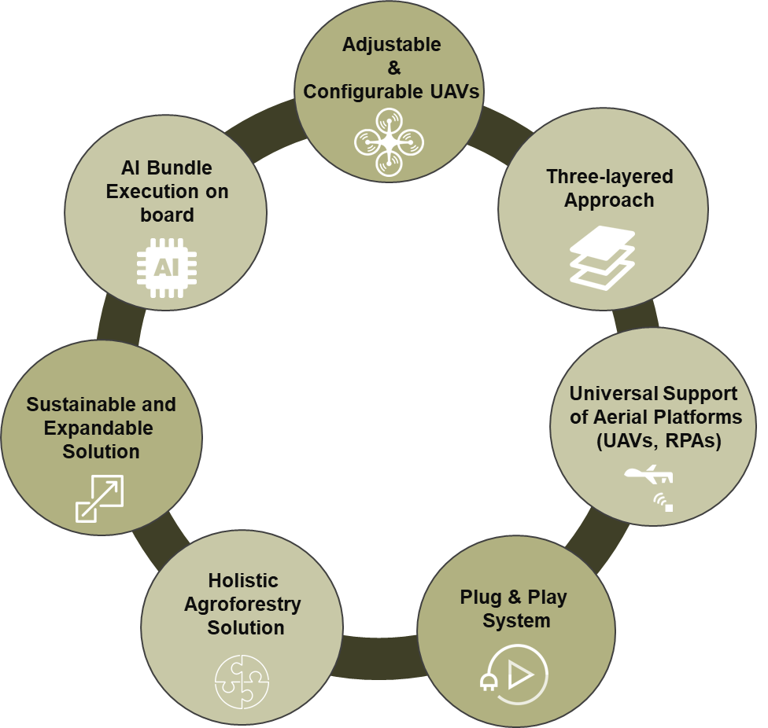
Objectives
2
OBJECTIVE 1
Introduce a new business model and ecosystem-oriented AI development and Big Data Platform, allowing the innovation of agriculture, forestry and livestock services and enabling new forms of communication and transactions between actors within the agriculture, forestry, livestock's business process

Slide 8
Objectives
2
OBJECTIVE 2
Address the needs of most complex agricultural, forest, livestock ecosystems and rural environments, through UAV hardware and software system that is on demand and multipurpose

Slide 9
Objectives
2
OBJECTIVE 3
Introduce an advanced large-scale agriculture and forestry surveying, mapping and assessment framework including different platforms (UAV, RPAS) for a hierarchy of observation scales

Slide 10
Objectives
2
OBJECTIVE 4
Provide a suite of novel UAV - enabled AI applications and tools for sustainable agriculture, forestry, livestock ecosystems and rural area services

Slide 11
3
Approach

Slide 12
Agriculture
Livestock
Forestry
CO₂ sequestration and biomass estimation
Irrigation and water stress monitoring and management
Behavioural analysis and protection of livestock
Early and non-intrusive lameness detection
Plant health assessment toolkit
Selective spraying application for low-risk fertilization and forest health protection

Slide 13
4
Advanced Supporting Technologies

Slide 14
Advanced Supporting Technologies
4
Expandable and configurable UAVs
A highly novel UAV solution that is on demand and multi-purpose
Three layered approach
Data from low altitude drones, high altitude fixed wing UAVs and satellites
Universal support of aerial platform (UAVs, RPAs)
Through the implementation of the CHAMELEON App Store
AI algorithms execution on board
Assisted by the on-board NVIDIA GPU delivering incredible AI performance
Holistic agroforestry solution
Maximise the probability of potential problems identification across heterogeneous sources and networks

Slide 15
5
Pilots

Slide 16
Pilots
5
Pilot 1: Ávila, Spain
Forest fire defence plan for rural areas
Pilot 2: Crete, Greece
Livestock monitoring and management
Pilot 3: Austria
Forest monitor for potential dangers
& Vineyards monitoring

Slide 17
6
Expected Impact

Slide 18
Economic
Scientific
Environmental
Reduction of costs
Based on the initial estimations, the digitisation of surveillance and monitoring of agriculture, forestry, livestock and rural processes can reduce up to 10% of costs: minimising losses due to diseases and bad practices
Innovation
New breakthrough tools and technologies for the smart farming, plant, livestock and agri-environmental monitoring
Protection
Increase of plants and animals health
Better monitoring of illegal activities in forests

Slide 19
7
Timeline

Slide 20
Timeline: Milestones

Slide 21
8
Consortium

Slide 22
12 partners from 9 EU countries
6 SMEs:
3 Universities & Research centres:
3 End Users:

